Slide 1
Stay in Front of the Changing Digital Landscape
Presented by:
Raj Patel, Founder & CEO, INNsight
Manoj Vijayasekar, Founder & CEO, MavJay

Slide 2
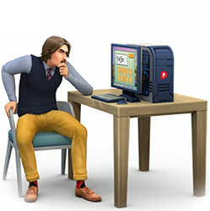
The New World
Social Media reviews are a big deal!
“77% usually or always reference reviews before selecting a hotel.”¹
Notes:
- It is clear now Social Media reviews have a major role in customer’s decision.
77% usually or always reference reviews before selecting a hotel.
- Majority of Hotels understand the importance of monitoring, analyzing, and engaging with prompt and personalized responses on all Social Media outlets
Responding to social media is reactionary. The business has no control over what is being said publicly.
Hotels don’t have control over what’s said on social media. However, they can help themselves by providing a channel for customers to share with you first.

Slide 3
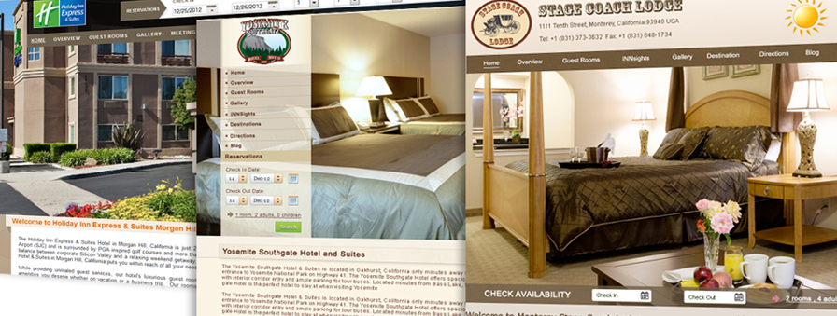
Your Standalone Hotel Website: Marry your online experience to your off-line one
It is imperative that you have your own standalone hotel website
Your standalone/vanity website should be designed to mimic your property’s look and feel, color scheme
Engage the customer from search, booking, pre check-in, check-out and review solicitation
Example Standalone Website: www.yosemitewestgate.com

Slide 4
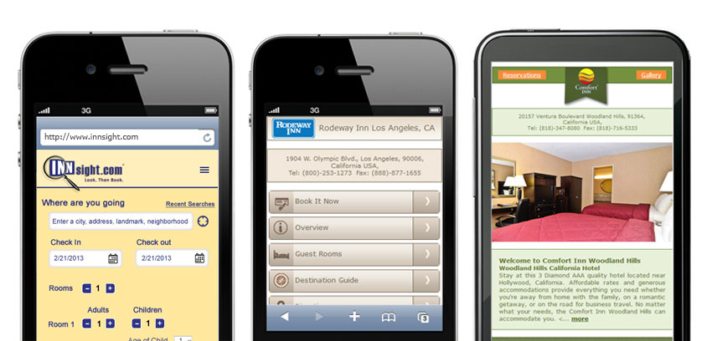
Mobile Websites are a MUST
With more travelers than ever before using their smartphones to book, it is imperative to have your website fully redesigned and compatible for mobile devices
If your website is not adaptive or responsive, you will frustrate visitors before they even arrive!

Slide 5
Customer Feedback
“91% of customers don’t always complain when they receive poor customer service with over 40% of them thinking it is not worth complaining as companies simply don’t care!”²
Notes:
Feedback can be broadly used for two purposes:
1. Marketing – ability to have conversation with satisfied and disgruntled customers
2. Operationally – to evaluate performance and to improve using customer driven data points
The measurement stick for any feedback system, is the response rate. In an ideal world, you want 100% participation.
From the quote, it’s clear customers want to know you care. Thus, how you approach them for the feedback and the design of the system are critical.

Slide 6
Feedback Design Factors
Data vs. Responses
Timing – When are Customers most willing? When is the experience clearest in mind?
Feedback loop
“81% of customers would be more likely to give feedback if they knew there would be an instant response.”³

Slide 7
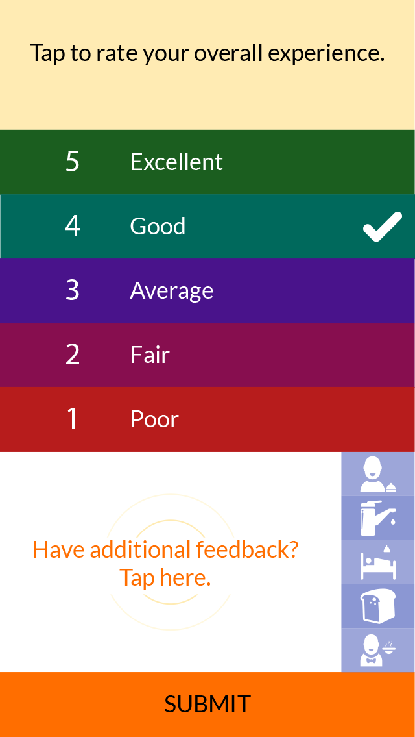
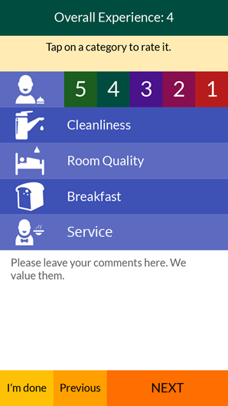
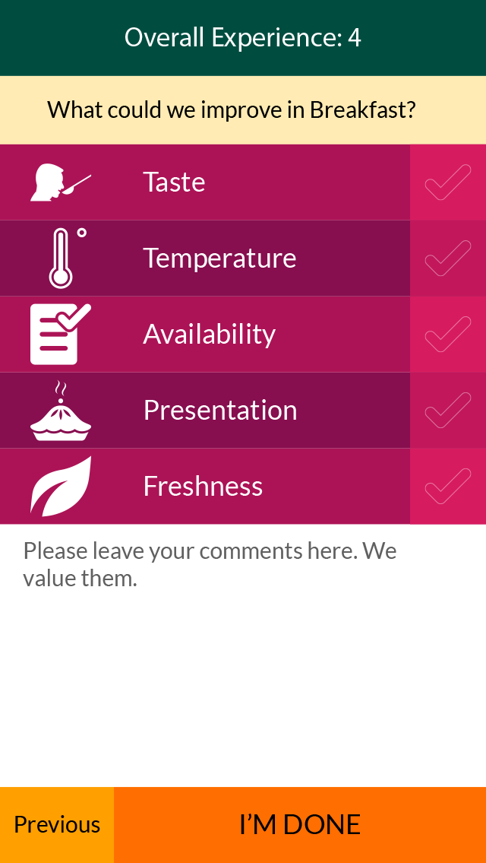

Slide 8
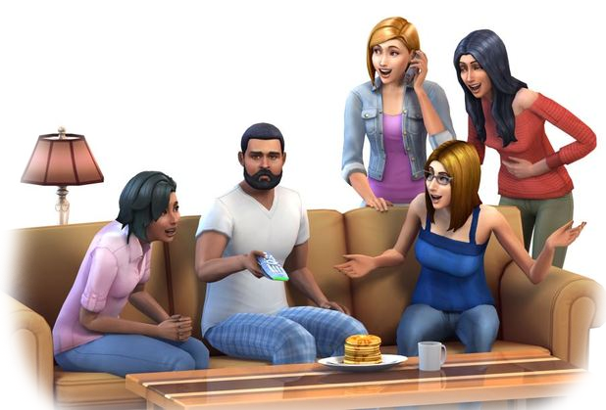
Feedback & Marketing
Curate your brand image
Drive word of mouth
Notes:
Curate your brand image using positive AND negative feedback.
Drive word of mouth using prompt responses and by creating personalized experiences
Positive comments can be posted on your website to boost Brand image
Negative comments - if changes are made from the customer feedback, it can be used on the website to demonstrate an openness to improve based on customers’ opinion
It’s an opportunity to start a dialogue.
Allows disgruntled customers an opportunity to reach out to you first.

Slide 9
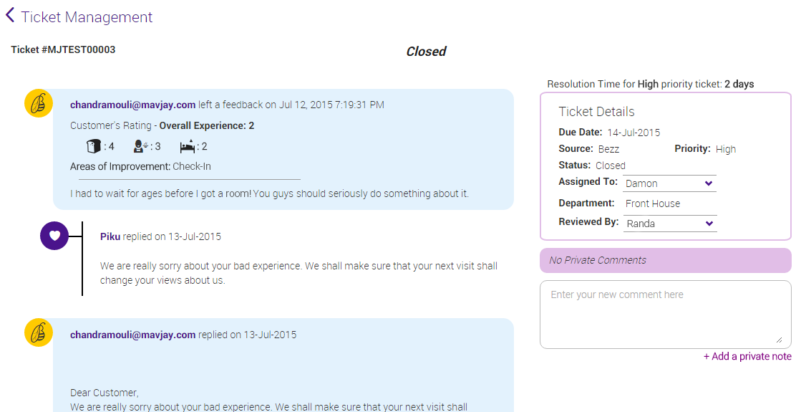
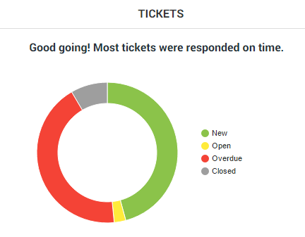
Service Recovery

Slide 10
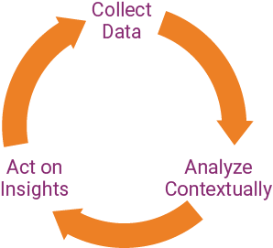
Feedback & Operations
Notes:
Authentic Data - Capture customer opinions on how they experienced your services
Contextual Analysis - Connect relevant information to understand what impacted a customer’s experience
Actionable Insights - Use data points to use service recovery processes, guide training, and manage change

Slide 11
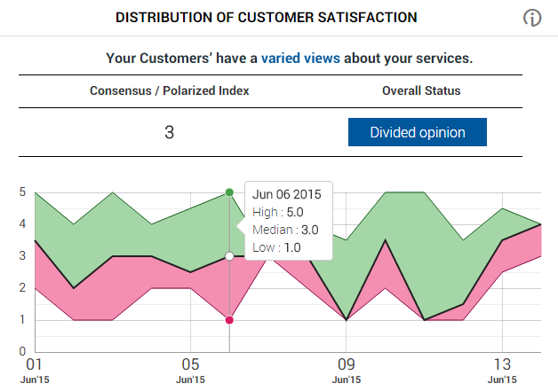
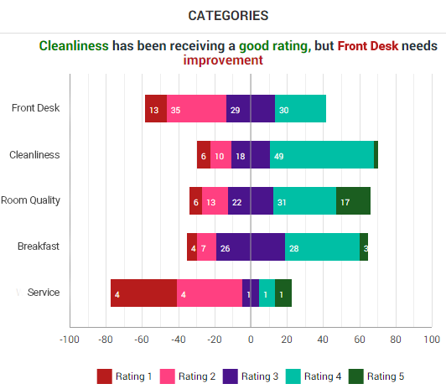
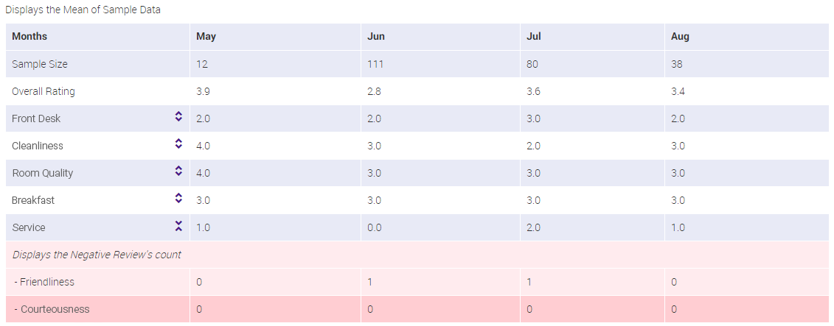

Slide 12
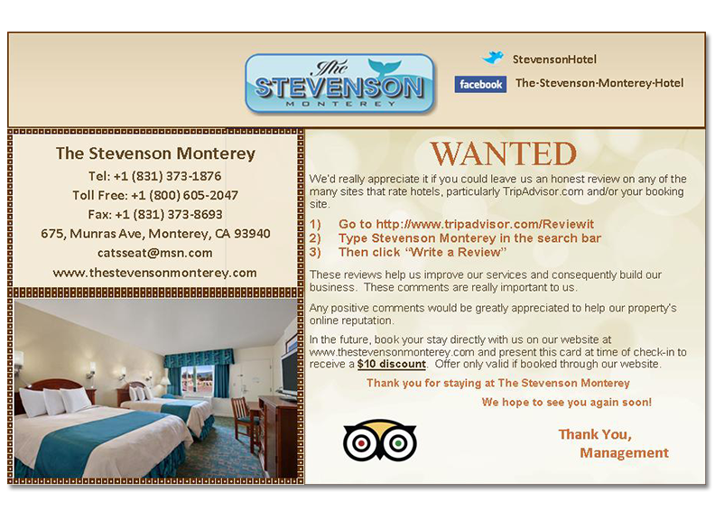
How to solicit and mediate public reviews
Solicit with a guest review card at check-out
Use a tool like MavJay’s to solicit feedback real-time to strike when the iron is hot
Re-affirm the solicitation with an email request if not completed on premise
Monitor all reviews sites and act fast to remedy reputation based situations that arise

Slide 13
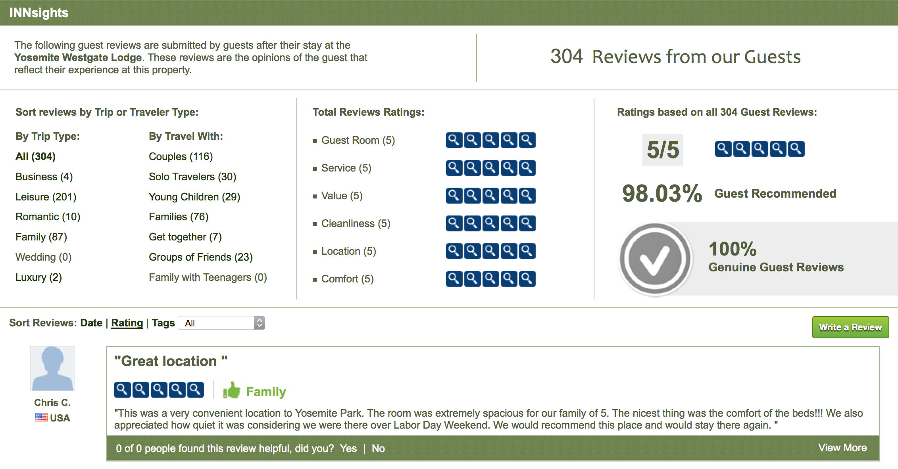
Direct Review Management
Does your hotel’s website display authentic reviews?
Are you monitoring OTA website reviews pages and using their applicable tools?
Are you actively managing your TripAdvisor, Yelp and Google Plus Pages?

Slide 14
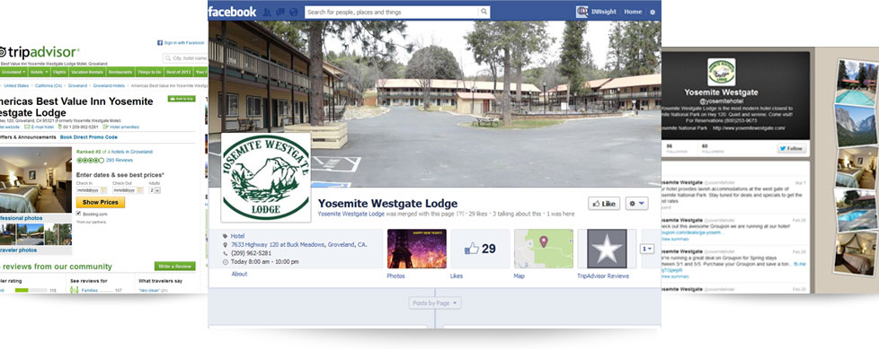
Social Media Management
Who is managing your social networks from Twitter and Facebook to Foursquare and Google+?
INNsight ensures that your property is displayed and highlighted correctly on Google Places, Yelp, TripAdvisor, Bing Maps, and Yahoo Local

Slide 15
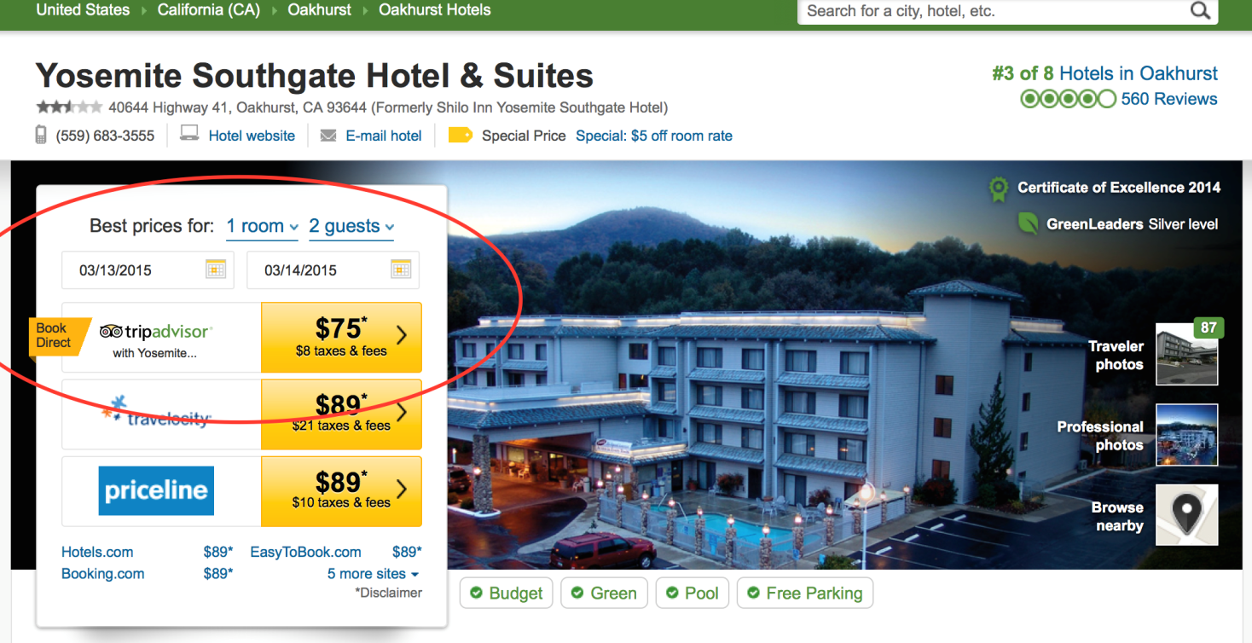
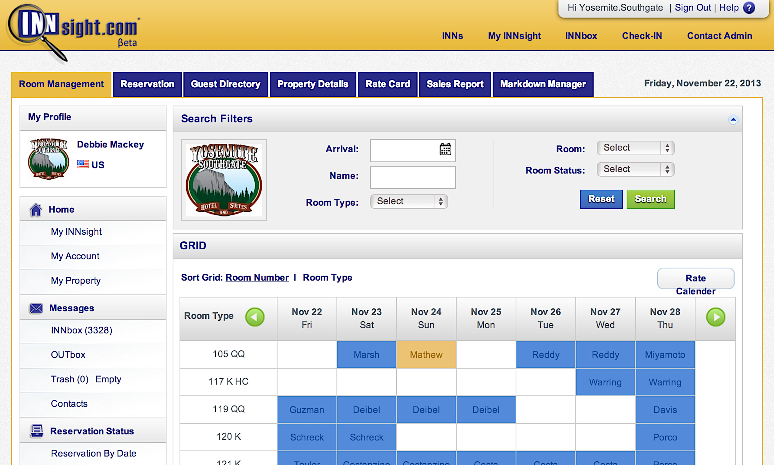
TripConnect: Leverage Public Reviews = Sales
Available?
Yes/No
Hotel manages rates and inventory on INNsight PMS with ease
Guest completes booking on TripConnect
All reservation details transmit to INNsight PMS
Reservation Fax is fired
Property Branded Reservation Confirmation Emails sent
Reservation Reminder Email queued
Thank You email soliciting review after check out
Full end-to-end booking integration that is Free, easy-to-use, and enable for Hotels

Slide 16
Thank You!
Any questions?
www.innsight.com/aboutus
www.mavjay.com
Contact us at:
Sales@INNsight.com
Or
Sales@MavJay.com

